Slide 1
Framing and organizing our work as rights of the child advocacy
7.3.2019
– the case of Rainbow Families Finland

Slide 2
Juha Jämsä
Executive Director
Rainbow Families Finland (Sateenkaariperheet ry)
juha.jamsa@sateenkaariperheet.fi
www.sateenkaariperheet.fi

Slide 3
Balancing in (lgbti) Family Associations
Rights of the adults
Access to parenthood
Rights of the children
Access to parental care
Blame from outside:
to selfishly require (reproduction) rights for lgbti adults is to play with children
Reality:
associations founded by parents for the protection of their existing kids

Slide 4
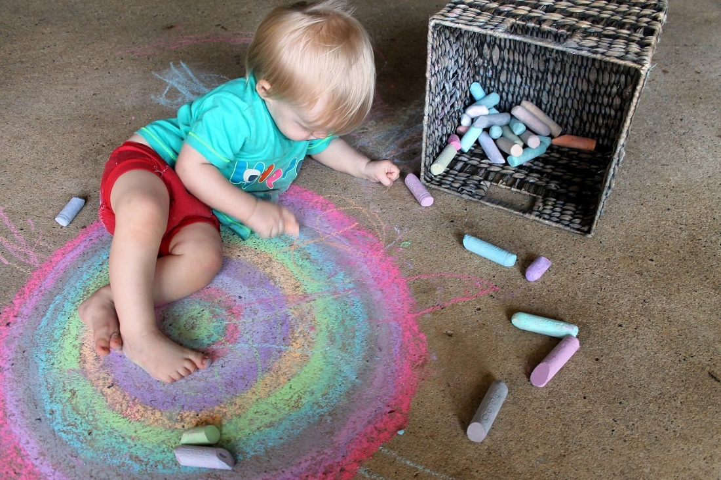
Placing Rights of the Child in Focus
Political aims
Strategic networking
Participation of children
Support for families

Slide 5
Framing Political Aims as Rights of the Child
Parental leaves (2017) for rainbow families
the right of the child to have her parents at home taking care of her
Right of access (2019) for de facto parents
the right of the child to have access to all of her de facto parents
Maternity Act (2019) for female couples
The right of the child to have her both mothers recognised from birth

Slide 6
Maternity Act
Maternal recognition without need to adopt
Government 2011-2015 tried to legislate, but failed
Current government wasn’t willing to do anything
We organised citizens’ initiative to pass the proposal in the parliament (requires 50 000 signatories)
Half a year media campaign resulted in:
Clear articulation of the rights of the child perspective
Most Finns have some idea about Maternity Act
EVERY major Finnish children’s rights association and authority was in favour of the initiative
Parliament ruled in favour by landslide: 122 – 42

Slide 7
Arguments for Maternity Act
Through Maternity Act the child….
will have right to both of her parents
will have right of access, maintenance and heritage even if her parents divorce
will not become an orphan if her birth mother dies
will still have right to her father if she has one

Slide 9
Strategic Networking
Central Union for Child Welfare
“We are child protection association”
Diverse Families –network
“Actually, we are not so marginal”
Ombudsman for children
”Our children are protected by the CRC”
Child welfare research networks
”We are dedicated to wellbeing of the children”

Slide 10
Participation of Children
Study of the well-being of children (n=106)
Surveys for children
Kids and youth activities planned by themselves
Giving public voice to experiences of children raised in rainbow families

Slide 11
Children’s Rights = Adults’ Responsibilities
Helping parents in their duty to ensure children’s rights:
Parenthood Couching to secure legal and psychological security for the kids
Support for parents and children in divorce
Support for parents’ intimate relationships
Parenting skills trainings and groups

